Slide 1
# Data Science Project
Genetic Variant Classification
Group #5
Chenyu Huang
Notes:
Morning Everyone, my name is Chenyu Huang, my project is Genetic Variant Classification

Slide 2
Clinvar Dataset
Intro
Labels
Good / Bad?
(non-conflicting)
Human Genetic Variants
37 Features
24 Categorical
13 Numerical
65,188 Variants
2 Labels
0 -> not conflicting
1 -> conflicting
Clinic 1
1
Clinic 2
1
Variant 1
0
……
1
Clinic n
1
Clinic 1
1
(conflicting)
Clinic 2
0
Variant 2
1
……
1
Clinic n
1
Notes:
First, let’s talk about the Dataset
I have over 60,000 genetic variants, and each variant has 37 features.
Each variant has a label, what is this label?
There will be several clinics making diagnosis, telling us whether the variant is benign or neutral, or pathogenic
If all clinics have the same diagnosis, this variant is classified as label 0, which stands for non-conflicting, otherwise, it will be classified as label 1 -- conflicting

Slide 3
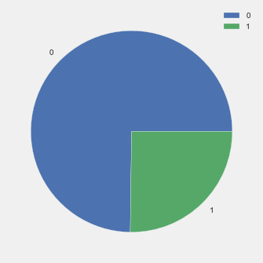
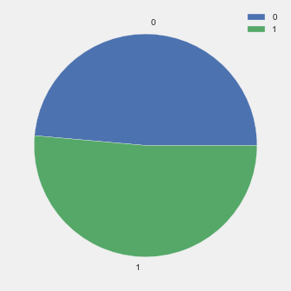
Exploratory Data Analysis
Omit ‘Null’ values
Balance Data
Resampling
Scale Data
Normalized Numerical Data -> within [0, 1]
Some ALGO: Map Categorical Data -> Numerical Value
Notes:
First things First
I omitted ‘Null’ Values, of course
over 75% of the whole dataset is marked label 0, so I resampled the imbalanced dataset to make it balanced
And I normalized the numerical data to simplify the computation, and for some algorithms, I mapped categorical data to numerical values

Slide 4
Questions
Variants Classification
Question:
Estimate how many variants will have conflicting classifications, why are they considered to have conflicting classifications?
Methodology:
Logistic Regression, Decision Tree
2. Weight of Features
Question:
Evaluate the importance of all these features, find the most important one and analyze why is it so important.
Methodology:
Random Forest (Bootstrapping)
3. Variants Clustering
Question:
Cluster with classification label unknown
Methodology:
K-means Clustering
Notes:
I have 3 questions in all

Slide 5
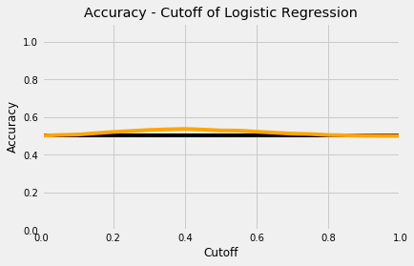
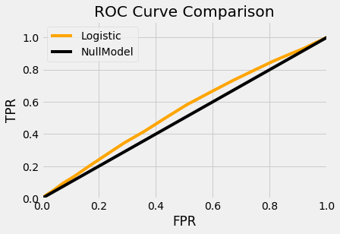
Q1: Variants Classification
Method 1: Logistic Regression
Mapped Categorical Data to Numerical Values
Simply used sklearn
Performance
Acc = 53.6%
AUC = 0.544
Notes:
My first algorithm is logistic regression, and it turns out the effect is just slightly better then the null model
It suppose this indicates that this dataset cannot be easily interpreted with linear model

Slide 6
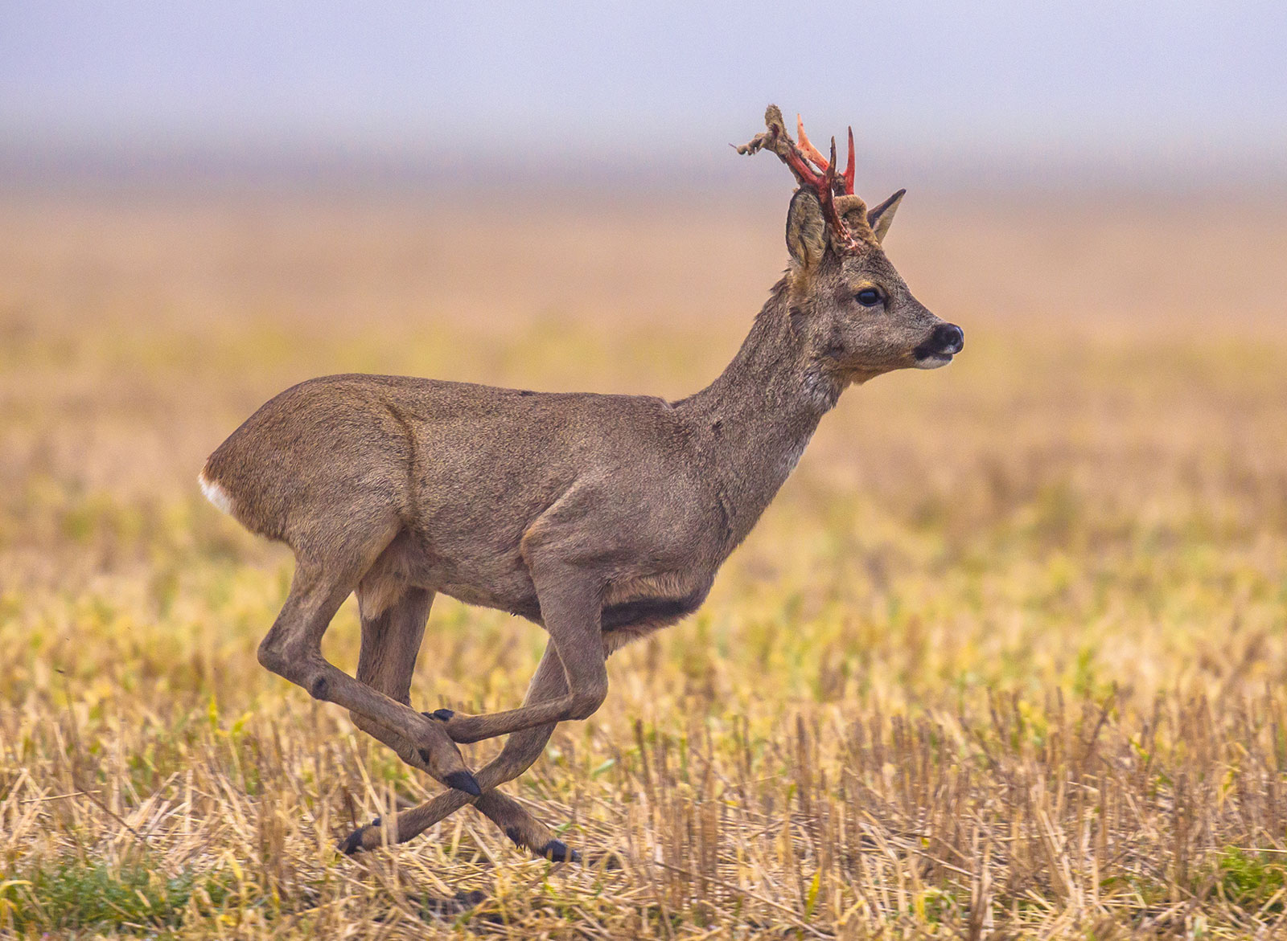
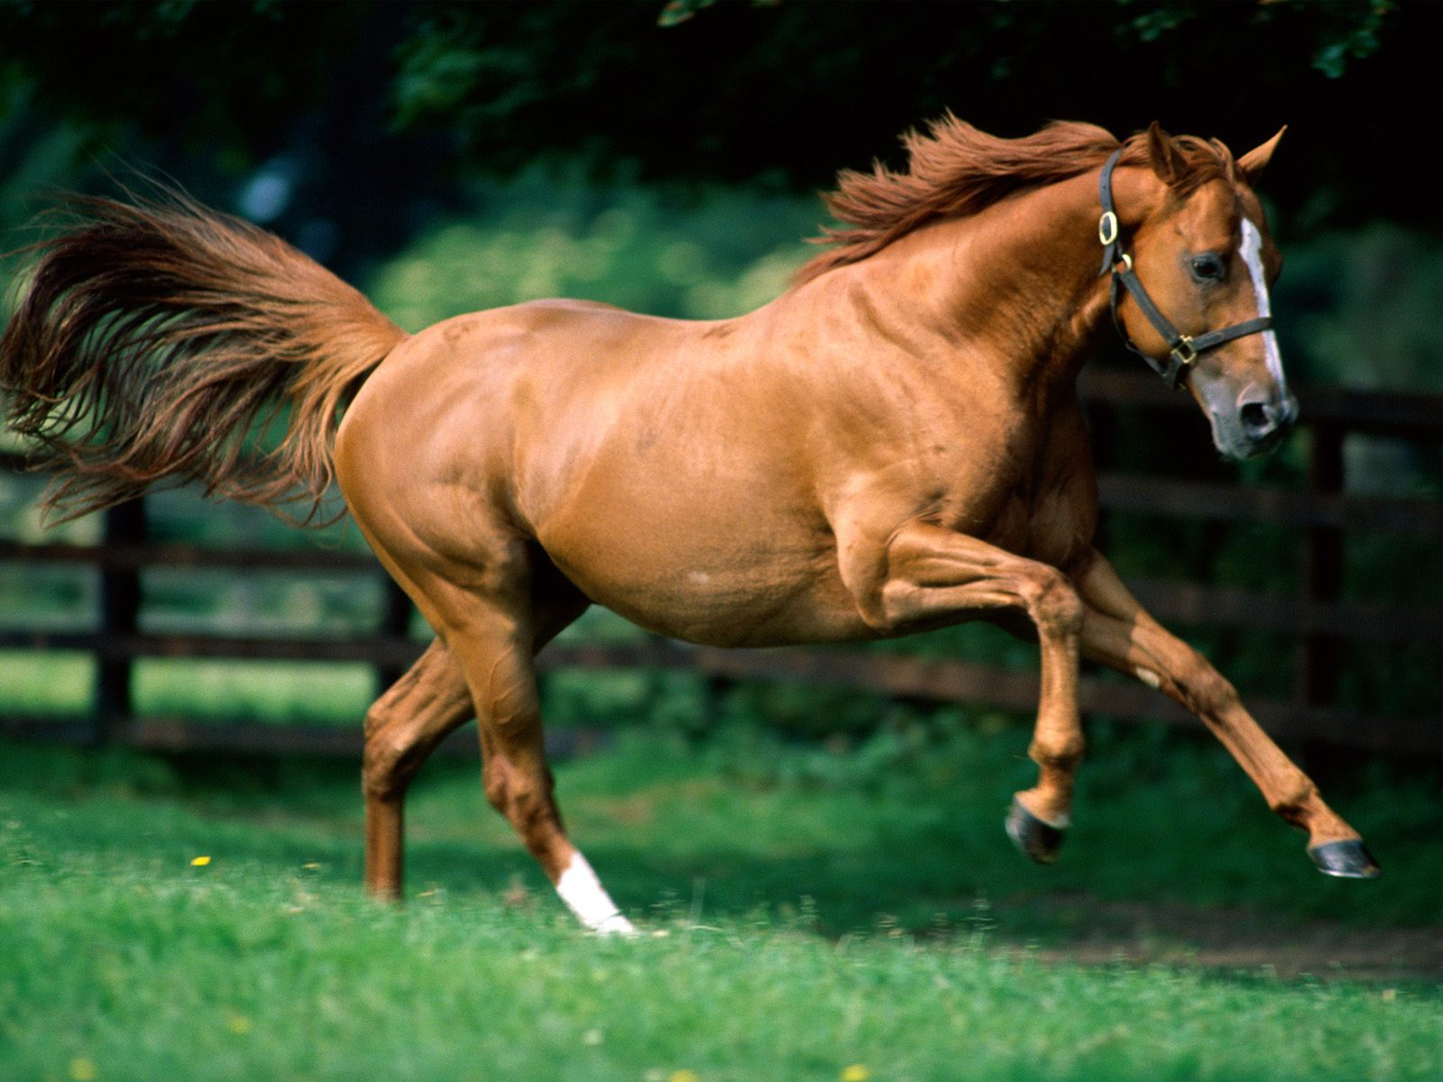

Q1: Variants Classification
Method 2: Decision Tree
What if
We cannot see the whole picture
We are only allowed to ask yes or no questions
After several rounds we will be able to tell them apart
Does it have corns?
no
yes
Horse
Deer
Reference: https://ocw.mit.edu/courses/sloan-school-of-management/15-097-prediction-machine-learning-and-statistics-spring-2012/lecture-notes/MIT15_097S12_lec08.pdf
Notes:
So then I used another algorithm called decision tree
Here’s the main idea of decision tree:
How do you tell apart a deer and a horse, you can do this with a simple glance
But what if you cannot see the whole picture and you are only allowed to ask yes / no questions?
This is the basic logic of decision tree, after several recursions, we will be able to tell them apart.

Slide 7
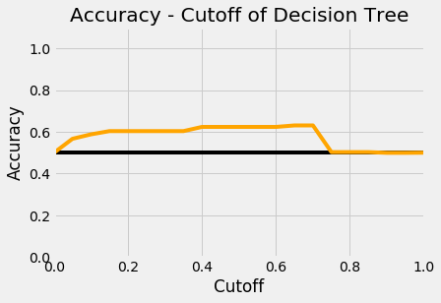
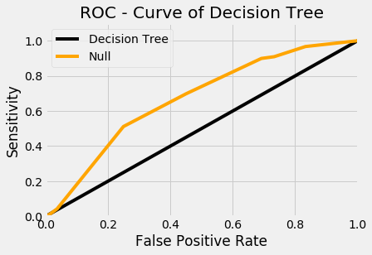
Q1: Variants Classification
Method 2: Decision Tree
Performance
Acc = 63.1%
AUC = 0.669
Acc – Cutoff curve
ROC Curve
Notes:
Here is the performance of decision tree, looks better than logistic regression huh
The accuracy achieves 63%, and AUC is 0.669
Let’s temporarily leave it here and move on to Question 2

Slide 8
Q2: Weight of Features – Feature Selection
Method: Random Forest
Random Subset
of Features
Bootstrapped Dataset 1
Decision Tree 1
Bootstrapped Dataset 2
Decision Tree 2
Dataset
Random Forest
……
……
Bootstrapped Dataset i
Decision Tree i
Main Idea:
Fix 1 feature in the subset, randomly pick a few more features
Evaluate the importance of this fixed feature according to the average Acc
Reference: https://www.youtube.com/watch?v=J4Wdy0Wc_xQ
Notes:
For question 2: it’s asking that among all features of the variant, which features are of more important while which ones are of less.
So I used an algorithm in Ensemble Learning, called random forest
Which is an ensemble of several decision trees, each tree trained on a bootstrapped dataset
How does this algorithm solve question 2 ?
I fixed 1 feature in the subset, randomly pick a few more features…

Slide 9
Q2: Weight of Features
Method: Random Forest
Relative Frequency of variant of a gene
Feature Number = 5
Feature | Acc | Interpretation
AF_EXAC | 0.661 | Allele frequencies from ExAC
CLNVI | 0.650 | The Variant's clinical sources reported as tag-value pairs of database and variant identifier
cDNA_position | 0.638 | Relative Position of base pair in cDNA sequence
BIOTYPE | 0.612 | Biotype of transcript or regulatory feature
STRAND | 0.604 | Defined as + (forward) or - (reverse).
Notes:
I sorted the features by accuracy and listed the top 5 features here
Looking at the first feature, it’s the relative frequency of variant of a gene
Wow, that sounds extremely important in classifying these variants even though I don’t know anything about biology

Slide 10
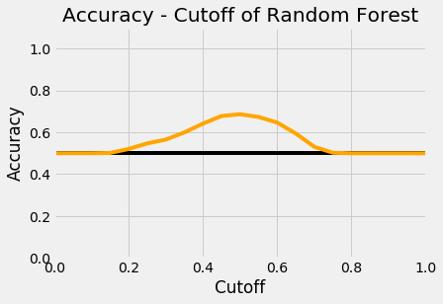
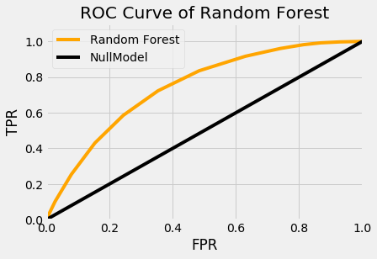
Recall Q1: -> Random Forest for Q1
Method 3: Random Forest
Acc – Cutoff curve
ROC Curve
 | Logistic | DecisionTree | RandomForest
Avg ACC(%) | 53.6% | 63.1% | 68.6%
AUC | 0.544 | 0.669 | 0.747
Notes:
See the Accuracy and ROC of random forest, 68% acc,
Looks like Random Forest is the winner so far

Slide 11
Q1: Variants Classification
Method 4: Adaboost
AoS = Amount of Say
Given according to its misclassification rate
Boosting
AoS = 8
AoS = 2
Weighted Average
Voting
Boosting
AoS = 1
AoS = 7
Boosting
Reference: https://www.youtube.com/watch?v=LsK-xG1cLYA
Notes:
Then I used another tree-based algorithm which is very similar with random forest, namely Adaboost
It’s not blindly letting all trees vote and take the average any more, each tree in adaboost, has an amount of say, according to it’s misclassification rate, the more accurate this tree is, the more amount of say it has.
So the final prediction of Adaboost is a weighted average of voting

Slide 12
Q1: Variants Classification
Method 4: Adaboost
Boosting Training Set
Iteration 1
Iteration 2
Make training set smaller
Losing Diversity
Overfitting
Notes:
Sounds good, but Adaboost has a problem,
While boosting the training set, it tends to make the training set smaller and smaller
because misclassified data are more likely to enter the next iteration, it will gradually lose diversity iteration by iteration, which will lead to overfitting.
So i have to feed in a great amount of data to train it.

Slide 13
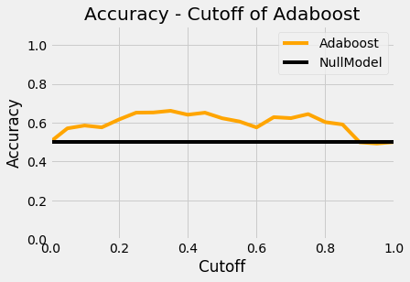
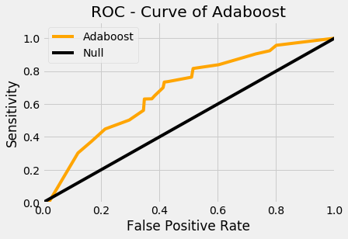
Q1: Variants Classification
Method 4: Adaboost
Acc – Cutoff curve
ROC Curve
 | Logistic | DecisionTree | RandomForest | Adaboost
Avg ACC(%) | 53.6% | 63.1% | 68.6% | 66.2%
AUC | 0.544 | 0.669 | 0.747 | 0.679
Notes:
Now let the figures speak for themselves

Slide 14
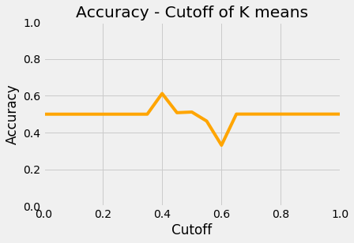
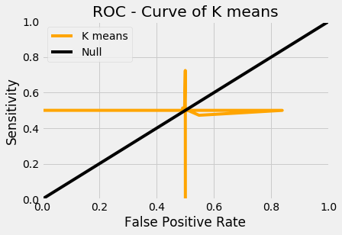
Q3: Variants Clustering
Method: K-means
Clustering = Classification without Labels
Acc – Cutoff curve
ROC Curve
Reference: https://www.youtube.com/watch?v=4b5d3muPQmA
Notes:
Finally, we reached the last question!
It asked me to do the classification without labels, which is known as clustering.
I’m not gonna dip into the detail of Kmeans algorithm because of the time limit, let’s just see the final result.
It’s totally not working!!!

Slide 15
Q3: Variants Clustering
Method: K-means
Why not WORKING!!
Recall
Categorically Similar
37 Features
24 Categorical
13 Numerical
Mapping
Numerically Similar
37 Numerical
Before Map | After Map | Normalized
‘A’ | 0 | 0
‘B’ | 1 | 0.25
‘C’ | 2 | 0.5
‘D’ | 3 | 0.75
‘E’ | 4 | 1
Similarity of Indices -> Random!
65% of the features are categorical
Notes:
Why is it not working???
What have I done to this dataset?
I mapped the categorical data to be numerical
So the original categorical similarity has been overwritten, and becomes a numerical similarity, which has nothing to do with the original dataset, it’s totally random, and 65% of the features are categorical.
No wonder it’s not working.

Slide 16
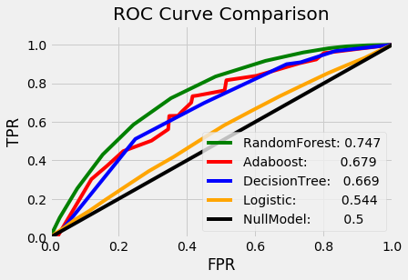
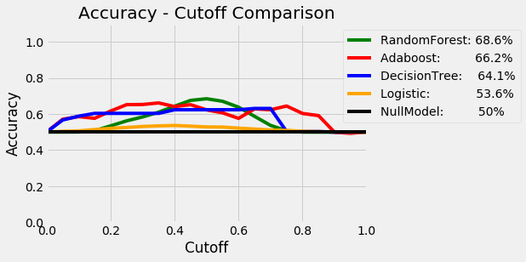
Conclusions:
Tree-based Classifiers works better when there are lots of Categorical Data
2. Power of Ensemble Learning
3. Lack of well-organized preprocessing & feature engineering
Notes:
Time for conclusions:
1. Looking at the accuracy and the ROC curves, tree based algorithms are the top 3 algorithms in this project
2. And I realized the power of ensemble learning, simply ensembling several weak learners can achieve a better performance
3. Finally, this project is actually insufficient in preprocessing and feature engineering, according to the messy performance of K-means

Slide 17
# Thank you !
Open Source Later
github.com/frostace/BinaryClassification
Group #5
Chenyu Huang

